Slide 1
Data Analytics Jeffrey Strickland, Ph.D.
“Let us above all take heed that one misfortune does not befall us. Let us not become misologues as some people become misanthropes; for no greater evil can befall men than to become haters of reason.”
—Plato

Slide 2
About Dr. Strickland
Ph.D. in Mathematics
M.S. in Operations Research
B.S. in Biology
Associates of Applied Science in Allied Health – Emergency Medical Technician
Certified Modeling and Simulation Professional
Microsoft Certified Technology Specialist
Companies Owned
Simulation Educators
Humalytica Analytics
Legacy Family Travel
Husband, Father, Hiker
Companies Worked For
US Army
NASA
Northrop Grumman
Clarity Solution Group
USAA

Slide 3
Data Analytics Project
Automobile Loan Uplift Model
Automobile Insurance Uplift Model
Term Life Insurance Uplift Model
Credit Card Uplift Model
Life Event Models (Marriage, Job Change)
Engagement Models – Financial Services
Call Center – Member Service Representatives
Web Life Interest Model
Text Analytics of Credit Card Transactions
Auto Experience Model
Used and New Car Purchases
Homebuyer Model Acquisition Model
Home Experience Model
Business Process Mapping

Slide 4
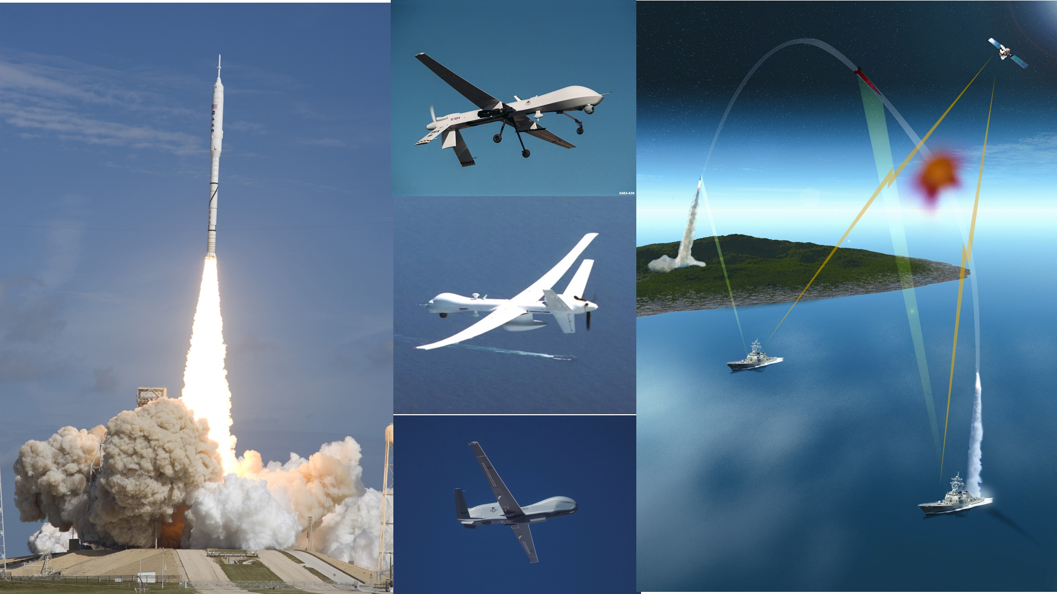
Modeling & Simulation Projects
Hunter Unmanned Aerial Vehicle (UAV)
Ballistic Missile Defense System (BMDS)
NASA Ares I
Crew Launch Vehicle
Warrior Extended Range Multi-Purpose (ERMP) Unmanned Aerial Vehicle (UAV)

Slide 5
Teaching Experience
United States Military Academy – Department of Mathematical Sciences
University of Northern Colorado – Department of Mathematics and Computer Science
University Of Alabama in Huntsville – Center for Modeling, Simulation and Analysis
Athens University – Department of Mathematics
Florida Institute of Technology – School of Advanced Graduate Studies
George Washington University – Curriculum Development
VIT University – Data Analytics in SITE

Slide 6

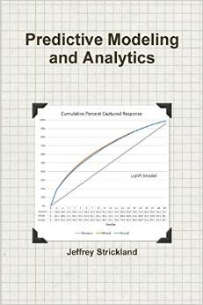

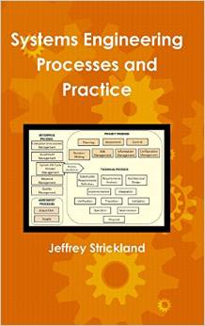
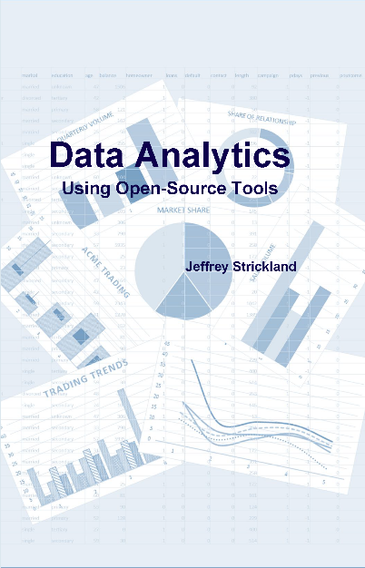



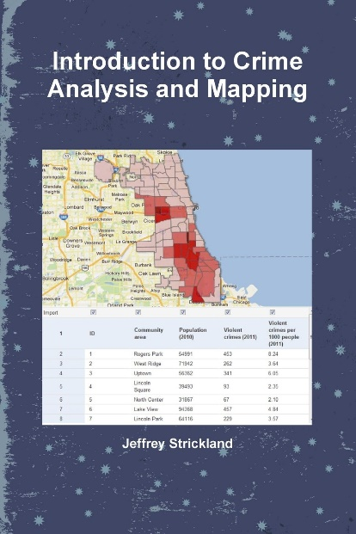

Books by Jeffrey Strickland

Slide 7
Data Science
The scientific pursuit of collecting, mining, exploring, analyzing and using data to support optimal decisions in business, science, medicine, social science, and industry.
Data collection
Data mining
Data exploration
Data analysis
Data modeling

Slide 8
Data Engineering (Data Engineer)
Convert data into a valuable format for investigation, inquiry, or analysis
Involves an extraction, transformation, and loading (ETL)
Design, build, and maintain data warehouses
Puts data into data warehouses
Design and structure of most data pipelines
Transform raw data to data that is ready for consumption

Slide 9
Database Architecture (Database Architect)
Relates to the composition of models, policies, rules or standards that govern data in systems and organizations:
collection
storage
arrangement
integration
utilization
Develops data models (e.g., logical data models), definitions, and data flows – Data Architecture artifacts
The artifacts allow for a common vocabulary that articulates the integrated data requirements
Ensures that data assets are arranged, stored, managed, and used in systems that support of an organization’s strategy

Slide 10
Database Management (Database Manager)
Any task that protects an organization’s data, ensures legality and compliance, and keeps data-driven applications performing optimally.
configuration management
storage and capacity planning
performance monitoring and modification
redundancy management and recovery
archiving, partitioning, masking, and retirement
Control data throughout its entire lifecycle, from requirements to through retirement
Prevent degradation of efficiency and enhance data integration for superior business intelligence, thereby increasing or sustaining revenue.

Slide 11
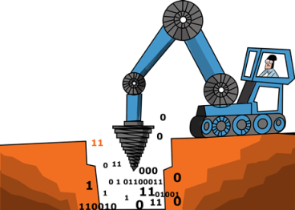
Data Mining (Data Analyst, Statistician)
The semi-automatic or automatic process of taking large quantities of data and extracting data that is pertinent to an organization’s data operations.
Pulls out interesting patterns such as groups of data records (cluster analysis)
Identifies items, events or observations which do not conform to an expected pattern (anomaly detection or outlier detection)
Finds frequent co-occurring associations among a collection of items (association rule mining or market basket analysis)
Discovers statistically relevant patterns between data examples where the values are delivered in a sequence (sequential pattern mining).
Involves using database techniques to find patterns, which may be used in further analysis or, for example, in machine learning and predictive analytics.
Data collection, data preparation, as well as the result
interpretation and reporting is not part of the data mining step.

Slide 12
Data Analytics (Data Scientist/Data Analyst)
A process of examining, cleaning, transforming, and modeling data with the goal of discovering useful information, informing conclusions, and providing decision support
Used in different business, science, medical, psychological, and social science domains
The goals of data analytics are discovering useful information, informing conclusions, and supporting decision-making
Includes exploratory data analysis to begin understanding the information contained in the data
Descriptive: the characteristics of the data that may help in understanding the data
Predictive: forecasting future events based on the data that has been mined and explored
Prescriptive: telling the story of why the data describes or predicts

Slide 13
Business Intelligence (BI Engineer, BI Analyst, BI Developer)
BI, often referred to a business analytics, pursues the transform of data into actionable intelligence that informs an organization’s strategic and tactical business decisions
Analysts use software tools, such as Tableau and SAS, to access and analyze pertinent business data and present the results, in a variety of “story telling” forms, to provide stakeholders with detailed intelligence about the state of the business
BI is a specialized area of data analytics
BI may describe a past or current state of the business and it also analyzes data to predict what will happen or what could happen by taking a certain approach.

Slide 14

Machine Learning (Data Scientist, Statistician, Computer Scientist, Physicist, Biologist, Cognitive Scientist)
ML is not the same thing as artificial intelligence (AI)
ML is the science of getting computers to act without being explicitly programmed
Many researchers think that ML is the best way to make progress towards human-level AI
ML is used to mine data, explore mined data, and predict future outcomes, and can be considered for use in data analytics or data mining
ML does not make use of traditional statistical of mathematics methods
ML algorithms may include artificial neural networks (ANN), random forests (RF), genetic algorithms (GA), and many other methods
ML is particularly useful in text analytics, where statistical methods are inappropriate.

Slide 15
Statistics (Statisticians)
The foundation of data science
It is the science that deals with the collection, classification, analysis, and interpretation of numerical facts or data
Supported directly by use of mathematical theories of probability, statistics imposes order and regularity on collections of dissimilar elements.
Must answer:
How was the data collected?
Does the evidence come from reliable sources?
What is the data’s background?
Are all data reported?
Have the data been interpreted correctly?
The application of mathematical and computational aspect of data science

Slide 16
The Disciplines of Data Analytics
Information Technology
Descriptive Statistics
Inferential Statistics
Computer Science (Machine Learning)
Computer Science (Programming)
Operations Research

Slide 17
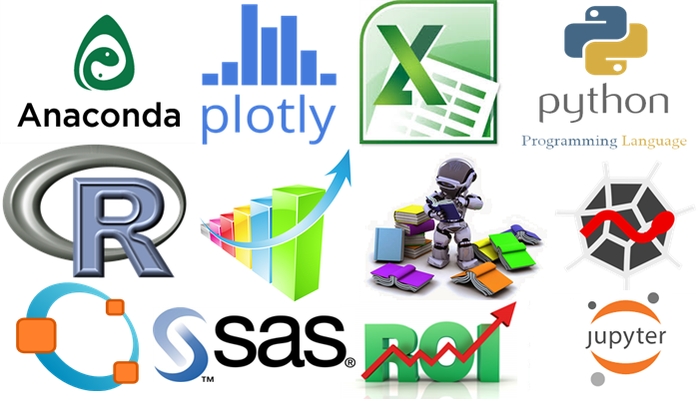
The Tools of Data Analytics
SQL
Hadoop
MapReduce
Apache Hive
Apache Pig
Apache Spark
SAS
R-programming
Python

Slide 18
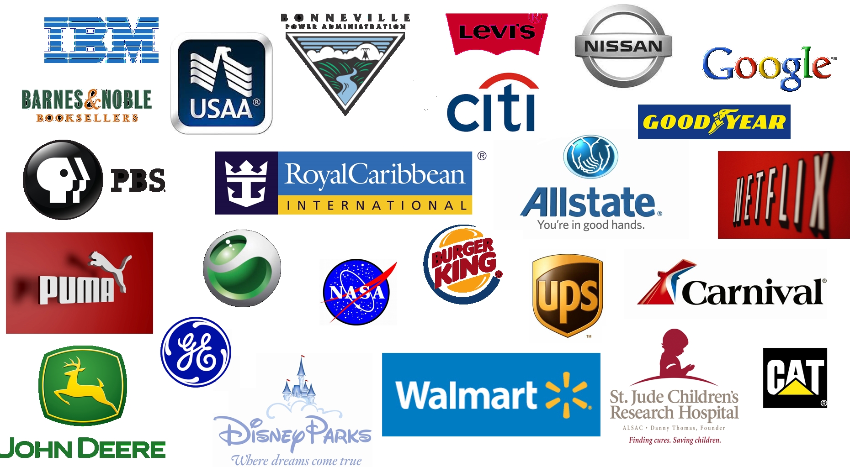
Who Uses Data Analytics

Slide 19
Customer Business Case
The Customer Business Case is a statement of the customer’s problem with a desired outcome
What is the desired outcome?
What are the metrics to be used?
What are the business rules to consider”
What is the real problem?

Slide 20
Analytics Objective
An objective in analytics language that corresponds to the business case
It uses the desired outcome
It is “technique vanilla” – does not express a soltion method
It will provide an answer the custom question

Slide 21
Target Outcome Data
What is the desired outcome?
What are the variables that might define the outcome?
Are the variables asesseble?
Are the variables obtainable?
Are there other data that may impact the target outcome?
Does the target outcome data show seasonality?

Slide 22
Explanatory Data
Data Characterization
Mean, medium, mode
Variance and standard deviation
Percent missing values
Quartiles, etc.
What percent of data records are missing?
What is the threshold?
Can missing data be logically imputed?
Averages
Medium values
Zeros

Slide 23

Data Integration
Data field
Data field
Data field
Join the data with the target variable
IDs
Target
Explanatory variables
Numeric
Flags
Nominal
Ordinal
Inner, out, left, outer-left joins
Eliminate unuseful data
Information Value
Weight of Evidence
Data field
Data field
Data field
Data field
Data field
Data field
Data field
Data field
Data field
Data field
Data field
Data field
Data field
Data field
Data field
Data field
Data field
Data field
Data field

Slide 24
Build Model
Determine the appropriate functional form
What does the target variable look like?
Binary?
Seasonal?
How much time do I have?
What supports the analysis objective?
What are the assumptions
Logistic Regression
Support VectorMachine
Neural Network
Naïve Bayes
Random forest

Slide 25
Test the Model
Performance Testing
Back-Testing
Based on model scores

Slide 26

Post-processing
Legal Review
Risk Review
Economic analysis
5-Year NPV = $1,791.00
Cost per direct mail = $0.45
Evaluated by pentile
About 9 million customers

Slide 27

Propensity to buy a new mortgage
New homeowners model
Buy a new home within next 3 months
Acquisition window = 3 months
Preprocessing period = 3 months
Profile window = 1 year
Target Data
Homeowner data from Core Logic
Reported by county
All 50 states
Compiled monthly
10 million plus audience
Independent variables
1 to 20 SAS databases
Up to 2000 variables
Up to 100 million records
Data Integration = four months

Slide 28
Contact Information
E-mail: jeff@humalytica.com
LinkedIn: https://www.linkedin.com/in/jeffreystrickland
Web site: www.humalytica.com
Skype: jeffrey.strickland2

